Slide 1

BANK Loan ANALYTICS
GROUP-4
Lavanya
Shubham Vishnu Kale
Ankita
Sri Kishan
Shyam Kumar

Slide 2
CONTENTS:
Introduction
Objective
Tools Used
KPI’s
Dashboard’s
Key Takeaways
Summary

Slide 3

INTRODUCTION
Bank analytics involves the application of data analytics in the banking industry. Data analytics is the science of analyzing raw data to draw conclusions and make informed decisions. In the context of banking, it refers to the use of structured and unstructured data from internal and external sources to gain actionable insights.

Slide 4

OBJECTIVE
The aim of this project is to analyze finance data provided by a financial institution for a diverse group of customers. The analysis will focus on customers with varied grades and sub-grade levels, taking into consideration various factors such as loan disbursement reasons, funded amount, revolving balance values, payment modes, and last payment values across different states and geolocations.

Slide 5





Why Is It Important To Analyze The Data?
Step 1
Step 2
Step 3
Step 4
Step 5
Understand your audience and customers better
Risk assessment and mitigation
Manage overall funds situation
Improve customer satisfaction and loyalty
Improved marketing and remarketing campaign planning

Slide 6



Role of analytics in banking
Risk
Supply
Demand
Fraud detection
Risk modelling for investment banks
Credit risk analysis
Sales performance analysis
Branch and online channel sales analysis
AI-driven chatbots & Virtual Assistants
Personalized marketing
Lifetime value prediction of Customers

Slide 7




TOOLS USED

Slide 8
KEY PERFORMANCE INDICATORS
FUNDED AMOUNT
PRINCIPAL RECEIVED
INTEREST EARNED
REVENUE
REVOLVE BALANCE
Funding reached 435 million in total.
Collected 389M total principal over 5 years (2007-2011) in loan repayments.
Accrued 90M interest from 2007 to 2011 over 5 years.
Revenue totals approximately 479 million.
Revolving balance stands at approximately 532 million.

Slide 9
Total Funded Amount
Funding reached 435 million in total.
Funding is money provided to individuals, organizations, or projects for financial needs or specific activities.
Most of the customer prefers a 36-month loan term, and the bank has approved a total funding amount of 276 million.
For the 60th month term the bank provided overall 159 million.

Slide 10
Total principal received
Collected 389M total principal over 5 years (2007-2011) in loan repayments.
The "principal received" refers to the initial amount of money that a borrower receives from a loan.
The highest collected principal was 226 million, collected in 2011.

Slide 11
Total Interest Earned
Accrued 90M interest from 2007 to 2011 over 5 years.
60-month loan: 0.148 APR offers extended financing with competitive interest rates.
36-month loan: 0.110 APR signifies favorable rates for shorter-term financial commitments.

Slide 12
Total Revenue Insights
Revenue totals approximately 479 million.
Received 389M principal over 5 years (2007-2011) in loan repayments.
Generated 90M interest from loans over 5 years (2007-2011).

Slide 13
Revolve Balance Overview
Revolving balance stands at approximately 532 million.
A significant increase in revolving balances could indicate that the bank is generating more revenue from interest and fees associated with revolving credit accounts.
Customers are actively using the bank's credit products, demonstrating engagement with the bank's offerings.

Slide 14
Year Wise Loan amount status
Total loan amount: $446 million
In total, the bank charged off 68 million, which should be carefully monitored as part of their risk management and financial stability efforts.
The fully paid amount is 358 million for 5 years (2007-2011) which indicates the successful management of credit risk and the bank's ability to recover funds lent to borrowers.
A higher proportion of fully paid loans contributes to a healthier balance sheet.

Slide 15
Grade and subgrade wise Revolve balance
Based on the Revolve balance our target customers should always be from Grade A and Grade B based on their creditworthiness.
Customers who fully paid their loan amount are higher in sub grades B, B3, B4, and B5.
Within the initial three grades—A, B, and C—remarkably, only 602 customers fall under the A grade, out of a total of 10,085. This noteworthy low charge-off rate identifies them as high-potential customers. Offering incentives and encouraging them to leverage more benefits and exclusive offers could be a strategic approach for further engagement and growth.

Slide 16
Payment for verified and non-verified status
Non-verification in the 154 million payment raises concerns about potential risks such as fraud or errors. Promptly address any discrepancies or concerns to maintain transparency and trust.
A verified payment of 220 million contributes to the bank's overall financial stability. Large, verified transactions enhance liquidity and provide assurance of sound financial health.
Assess the impact on customer relationships. Resolving issues promptly demonstrates commitment to customer satisfaction.

Slide 17
State wise and month wise Loan status
California, Florida, New Jersey, New York, and Texas have the highest number of customers who fully paid their loan amounts.
Five states with lower status numbers are Iowa, Idaho, Indiana, Maine, and Nebraska.
California state has the highest number of charged off in April (106) and the highest number of fully paid customers in March (609).
Maine has one of the lowest numbers in terms of status.

Slide 18
Home ownership vs Last payment date status
The last payment amount in 2012 was the highest, grossing 31.01 million overall.
The amount significantly decreased from its 2013 level to 5 million in 2015.
Continuously monitor borrowers' financial situations and adjust strategies accordingly. Regular reviews allow the bank to adapt to changes and proactively address potential issues.
Offer flexible payment plans that align with the borrower's current financial situation.

Slide 19





Dashboards and SQL queries
Excel
POWER BI
TABLEAU
SQL
KEY TAKEAWAYS

Slide 20
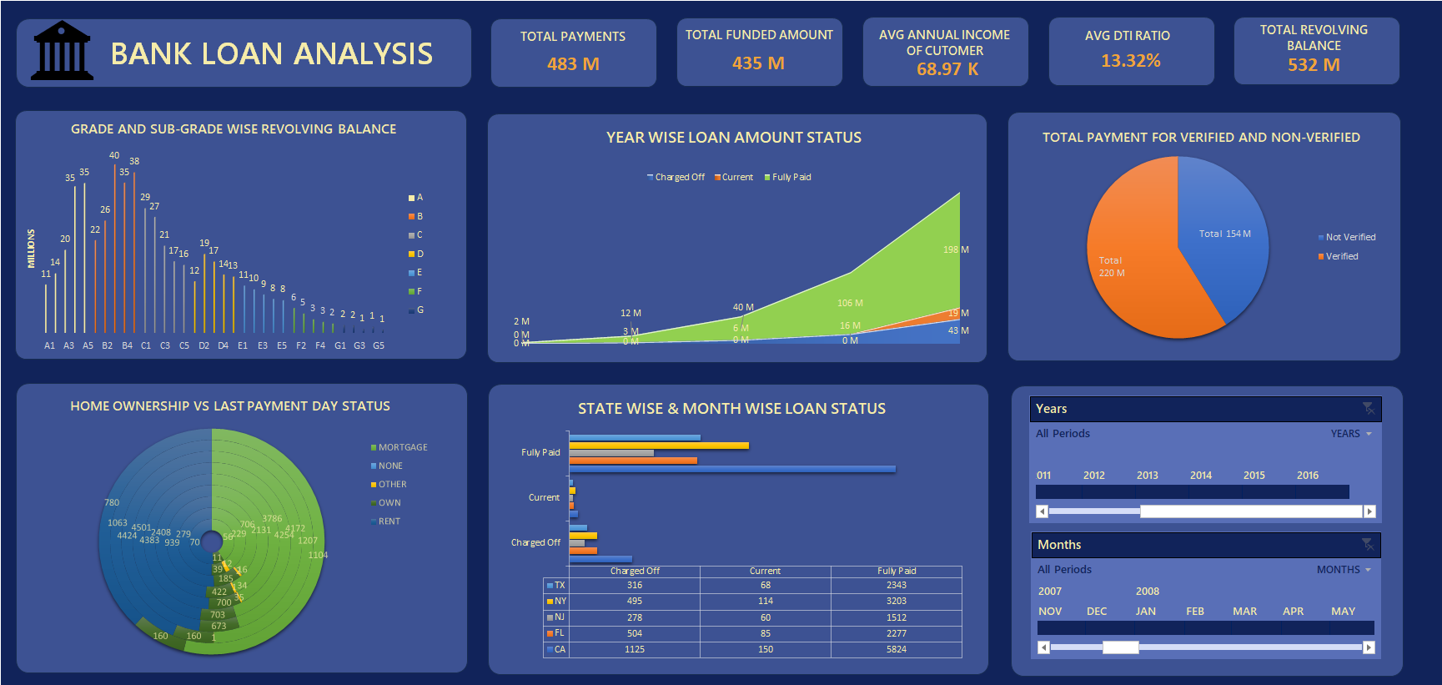
excel Dashboard

Slide 21
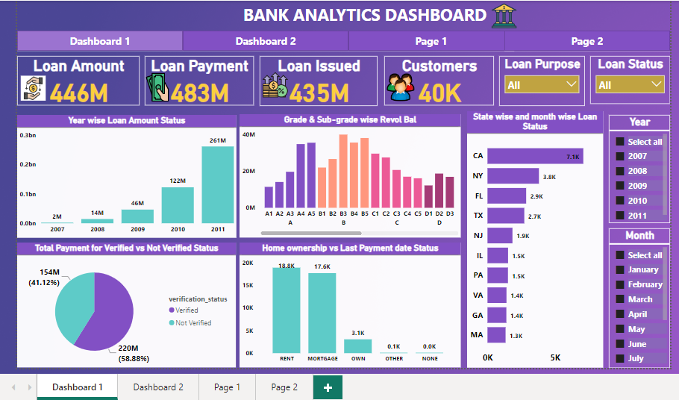
powerbi Dashboard

Slide 22
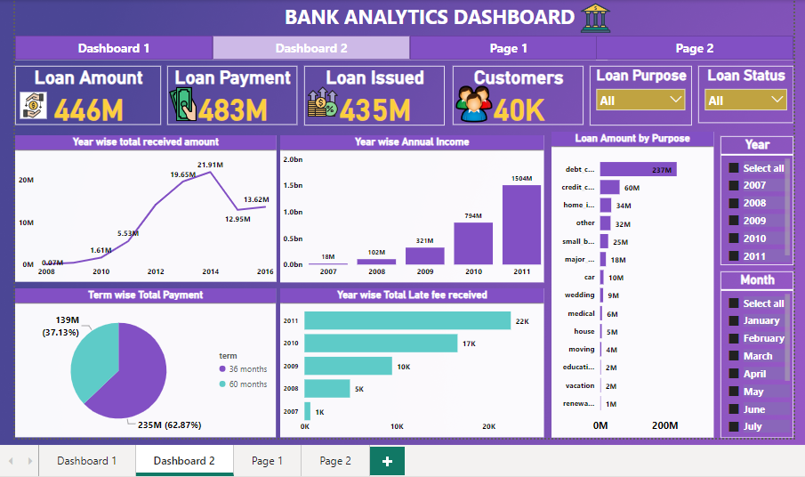
powerbi Dashboard

Slide 23
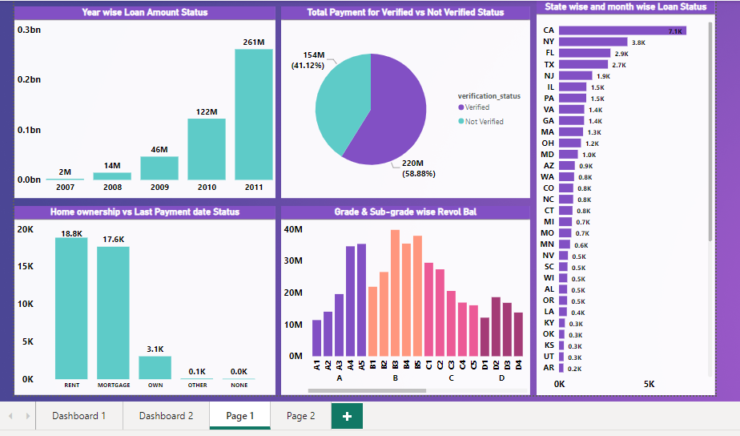
powerbi Dashboard

Slide 24
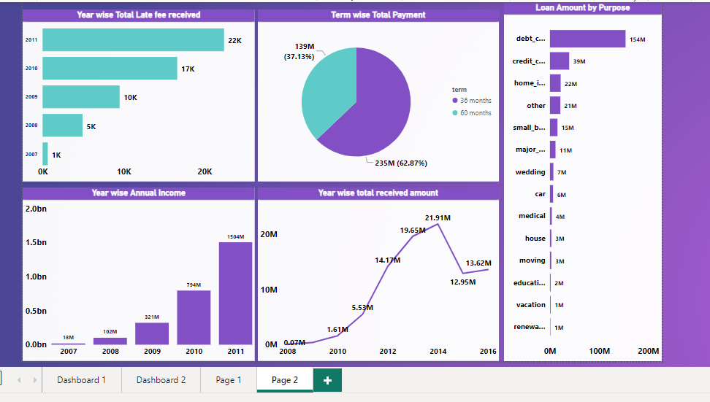
powerbi Dashboard

Slide 25
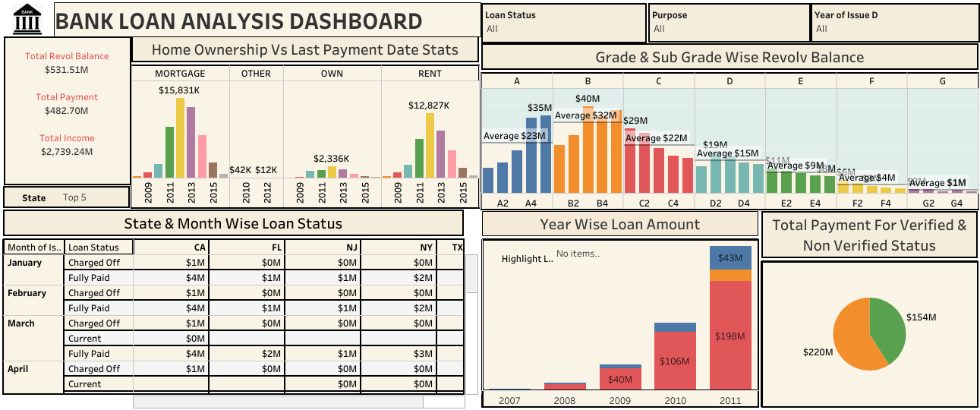
Tableau Dashboard

Slide 26
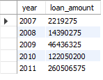

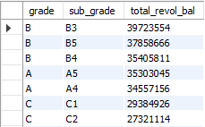

1. YEAR WISE LOAN AMOUNT STATUS
2. Grade and subgrade wise Revolve Balance

Slide 27
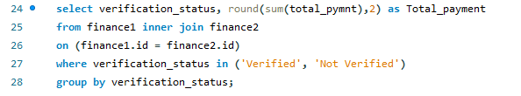

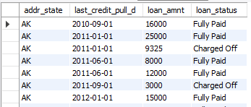

3. Total payment for verified and non-verified status
4. State and month wise loan status

Slide 28
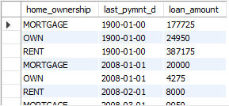
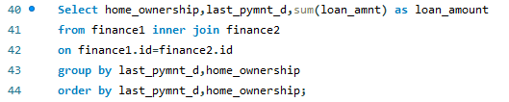


5. Home ownership vs last payment date status
KPI’s
a. Total funded amount

Slide 29





b. Total loan issued
c. Cumulative interest rate
d. Average funded amount

Slide 30
Key takeaways
Strategize
Minimize risk
Customers Education
Emphasize the provision of 36-month term loans featuring low-interest rates and enticing offers tailored for our loyal customers.
The sale of credit card products will contribute to an increase in your revolving balance.
Concentrate on customers in the A and B credit grades, with sub-grades such as A4, A5, B3, B4, and B5, as these segments comprise a higher proportion of creditworthy individuals.
Focus on verified payments to mitigate risks and prevent undue financial liabilities.
Provide educational materials to customers about the advantages and potential drawbacks of different loan terms.
Empower customers to make informed decisions based on their financial goals and circumstances.

Slide 31
SUMMARY
This analysis underscores a successful financial performance, with substantial revenue generation and a commendable net profit margin over the 5-year period, reflecting the bank's effective management of loan portfolios and interest earnings.

Slide 32
THANK YOU
GROUP 4
PROJECT NO: P-330

